Slide 1
Haiku Generator from Photo
By Summer and Evelyn Hasama
AIT-Budapest

Slide 2
Introduction
What is a Haiku?
a Japanese 5-7-5 syllable poem often relating to nature
What is this project?
We created a haiku text generating model which is a fine tuned GPT-2 model. With this model and an existing object detection model, we can get keywords from an input photo and output a related haiku

Slide 3
Dataset
Haiku Dataset by bfbarry on Kaggle
contains 11,269 haikus scraped and cleaned from the haiku subReddit
Haiku Dataset by Harshit Jhalani on Kaggle
contains over 118,000 English haikus gathered from multiple sources, only about 5,000 of which are used in training the model

Slide 4
Proposed Method
Cleaned our haiku datasets and used a GPT-2 tokenizer which is based on byte-level Byte-Pair-Encoding to encode each of our poems.
Used the PyTorch Trainer to fine tune the GPT2LMHeadModel.
We generated haikus from our nature related words and filtered out poems that do not follow the 5-7-5 syllable structure using the syllables Python library.
We used ImageAI’s Image Classification to provide us with image recognized objects in each input photo. We used these objects as keywords for our haiku generator to generate haikus related to each photo

Slide 5
Evaluation Method
We evaluate the poems generated using BERTScore, which was created by Cornell University scholars
The BERTScore has been shown to resemble human judgment on sentence-level and system-level evaluation.
We evaluate the haikus on the mean of the F1 measure, as this score combines both precision and recall.

Slide 6
Results
From all of the 60 nature keywords, we had 117 haikus generated. The average BERTScore was 0.55. Some example haikus include:
Keyword: root
root in the garden
a small flower grows with me
to be a small bud
Keyword: wind
winded from the sun
the wind blows the earth silent
the sea is waiting
Keyword: moss 🥲
moss in the garden
an old man in the garden
the old man is dead

Slide 7
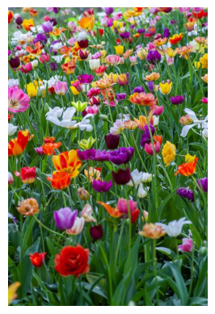
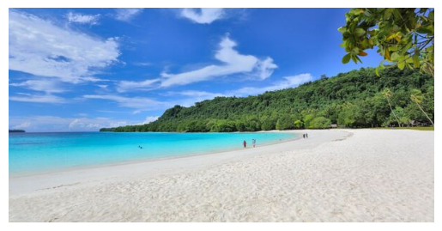
More Results
daisy in the tree
as the birds sing in the wind
my heart is the same
sandbar on the beach
the sandbar is too close
to the ocean floor

Slide 8
Thank You

